Slide 1
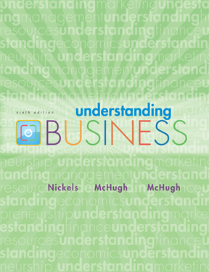
*
Chapter Seven
*
Management and Leadership
Tania Akter (TAK)
McGraw-Hill/Irwin
Copyright © 2010 by The McGraw-Hill Companies, Inc. All rights reserved.

Slide 2


TODAY’S MANAGEMENT
*
Managers’ Roles Are Evolving
*
LG1
Management is the process used to accomplish organizational goals through planning, organizing, leading and controlling people and other organizational resources.
7-<number>
Notes:
‘Management is a problem-solving process of effectively achieving organizational objectives through the efficient use of scarce resources in a changing environment.’
According to F.W. Taylor, ‘ Management is an art of knowing what to do when to do and see that it is done in the best and cheapest way ‘.
Megginson, Mosley, and Pietri define management as ‘working with human, financial and physical resources to achieve organizational objectives by performing the planning, organizing, leading and controlling functions‘.

Slide 3
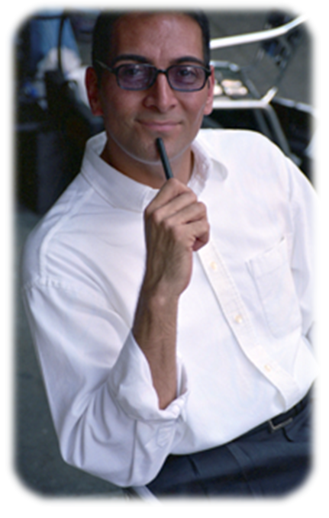
FOUR FUNCTIONS of
MANAGEMENT
*
Four Functions
of Management
*
LG2
  Planning
  Organizing
  Leading
  Controlling
7-<number>

Slide 4
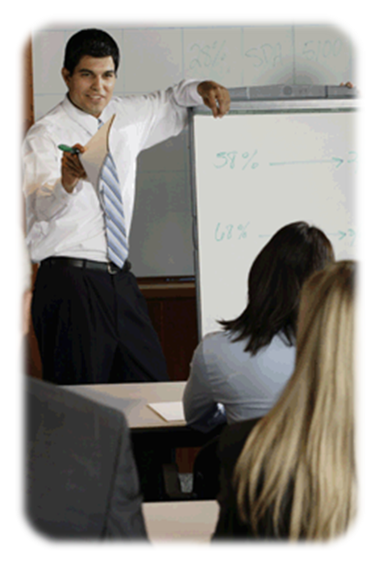
SHARING the VISION
*
Planning & Decision Making
*
Vision -- More than a goal, it’s a broad explanation of why the organization exists and where it’s trying to go. (future)
A mission statement outlines the organization’s fundamental purposes. (present)
Goals are the broad, long term accomplishments an organization wishes to attain.
Objectives are specific, short term statements detailing how to achieve the organization’s goals.
LG3
7-<number>

Slide 5
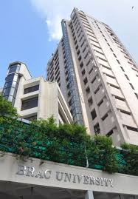
Brac University
VISION
To be a proud, global institution from Bangladesh
MISSION
To create and share knowledge
To uphold human values
To promote sustainability
OBJECTIVES
By 2024 to become:
Bangladesh’s international university;
Bangladesh’s student centric university;
A research university with impact.

Slide 6

BRAC
Our Vision
A world free from all forms of exploitation and discrimination where everyone has the opportunity to realise their potential.
Our Mission
Our mission is to empower people and communities in situations of poverty, illiteracy, disease and social injustice. Our interventions aim to achieve large scale, positive changes through economic and social programmes that enable men and women to realise their potential.
Our Values
Innovation
Integrity
Inclusiveness
Effectiveness

Slide 7

Vision
Amazon
"Our [Amazon's] vision is to be earth's most customer centric company; to build a place where people can come to find and discover anything they might want to buy online."

Slide 8

Mission
Brac University
Fostering Knowledge Creation
Upholding Human Values
Promoting Sustainable Development
. - See more at: https://www.bracu.ac.bd/about#mission

Slide 9

Examples of Goals and Objectives
A goal is a short statement of a desired outcome to be accomplished over a long time frame, usually three to five years. It is a broad statement that focuses on the desired results and does not describe the methods used to get the intended outcome.
Some common examples of business goals include the following:
Maximize profits
Grow revenues
Increase efficiency
Provide excellent customer service
Become an industry leader
Create a brand
Become carbon-neutral

Slide 10
Objectives
Objectives are specific, actionable targets that need to be achieved within a smaller time frame, such as a year or less, to reach a certain goal. Objectives describe the actions or activities involved in achieving a goal. For example, in order to achieve the goal of increasing revenues, a company can have an objective such as “Add three new products by the end of October this year.”
Following are some examples of objectives:
Earn a minimum of 15% return on investment (ROI) in a fiscal year
Increase the company’s market share to 7% by the end of next fiscal year
Cut down the operating costs by 10% within two years
Reduce the response time for sales inquiries to 12 hours by the end of this quarter

Slide 11
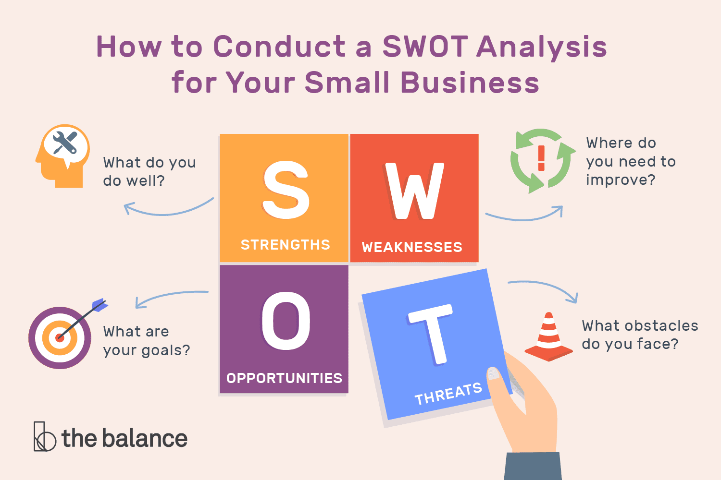
PLANNING ANSWERS
FUNDAMENTAL QUESTIONS
*
Planning & Decision Making
*
LG3
  What is the situation now?
    SWOT Analysis -- Analyzes the organization’s Strengths, Weaknesses, Opportunities and Threats.
7-<number>

Slide 12
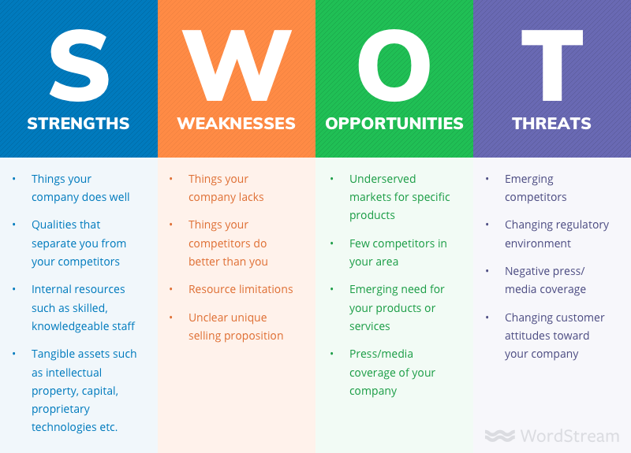

Slide 13
Potential Strengths Market leadership Strong research and development High-quality products Cost advantages Patents | Potential Weaknesses Large inventories Excess capacity for markets Management turnover Weak market image Lack of management depth
Potential Opportunities New overseas markets Falling trade barriers Competitors failing Diversification Economy rebounding | Potential Threats Market saturation Threat of takeover Low-cost foreign competition Slower market growth Growing government regulation

